Slide 1

aol
Logo Designed by
Terry Watkins

Slide 2

Platinum & Venue Sponsor
@uspto

Slide 3
aol
Logo Designed by
Terry Watkins

Slide 4
Wednesday Schedule at a Glance
9:00 – Keynotes
10:35 – Morning Break
12:05 – Ignite Talks
12:20 – Open Space Agenda
1:00 – Lunch
2:00 – Ignite Talks
2:20 – Open Spaces
3:30 – Afternoon Break
4:50 – Evening News
6:00 – Happy Hour at the Carlyle Club

Slide 5

Happy Hour Sponsor
@opsgenie

Slide 6

Happy Hour Sponsor
@aol_inc

Slide 7
aol
Logo Designed by
Terry Watkins

Slide 8


Staff & Volunteers

Slide 9

Platinum Sponsor
@pivotal
Notes:
Need High Res Logo

Slide 10

Platinum Sponsor
@cloudpassage

Slide 11

Platinum Sponsor
@netuitive

Slide 12
Etherpad
e.devopsdaysdc.org
We Are Hiring
Looking for Work
Reading List
Social Media
Feedback on DevOpsDays DC

Slide 13
Platinum Sponsor
@capitalone

Slide 14

Platinum Sponsor
@_eglobaltech

Slide 15

Platinum Sponsor
@excellaco

Slide 16
Etherpad
e.devopsdaysdc.org
We Are Hiring
Looking for Work
Reading List
Social Media
Feedback on DevOpsDays DC

Slide 17

Platinum Sponsor
@solarwinds

Slide 18
Platinum Sponsor
@csra_inc

Slide 19

Platinum Sponsor
@docker

Slide 20
Thursday Schedule at a Glance
9:00 – Keynotes
10:25 – Morning Break
11:55 – Ignite Talks
12:25 – Open Space Agenda
1:00 – Lunch
2:00 – Open Spaces
4:15 – DevOpsDays Podcast

Slide 21

Platinum Sponsor
@chef

Slide 22

Platinum Sponsor
@thoughtworks

Slide 23

Platinum Sponsor
@pagerduty

Slide 24

Happy Hour – Wednesday 6:00PM

Slide 25

Platinum Sponsor
@github

Slide 26

Platinum Sponsor
@customink

Slide 27

Platinum Sponsor
@redhatsoftware

Slide 28

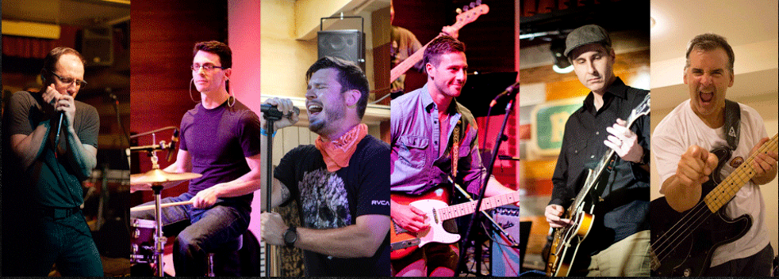

Slide 29

Platinum Sponsor
@ansible

Slide 30

Platinum Sponsor
@dltsolutions

Slide 31

Platinum Sponsor
@omniti

Slide 32
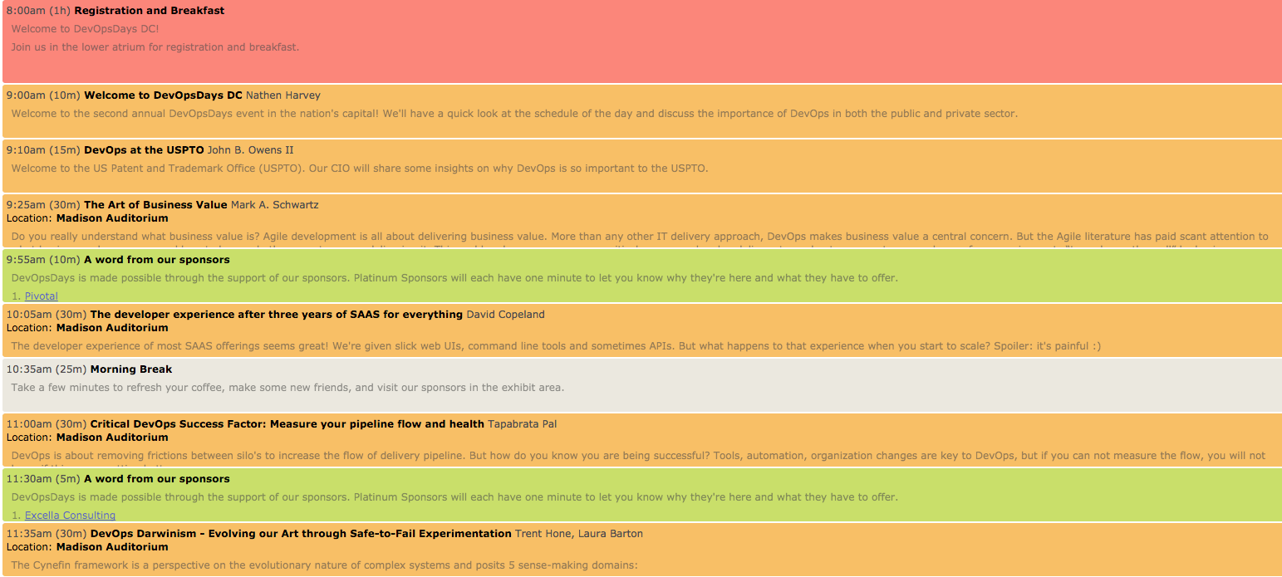
Wednesday Morning

Slide 33

Platinum Sponsor
@aspe_inc

Slide 34

Platinum Sponsor
@saucelabs

Slide 35
aol
Logo Designed by
Terry Watkins

Slide 36
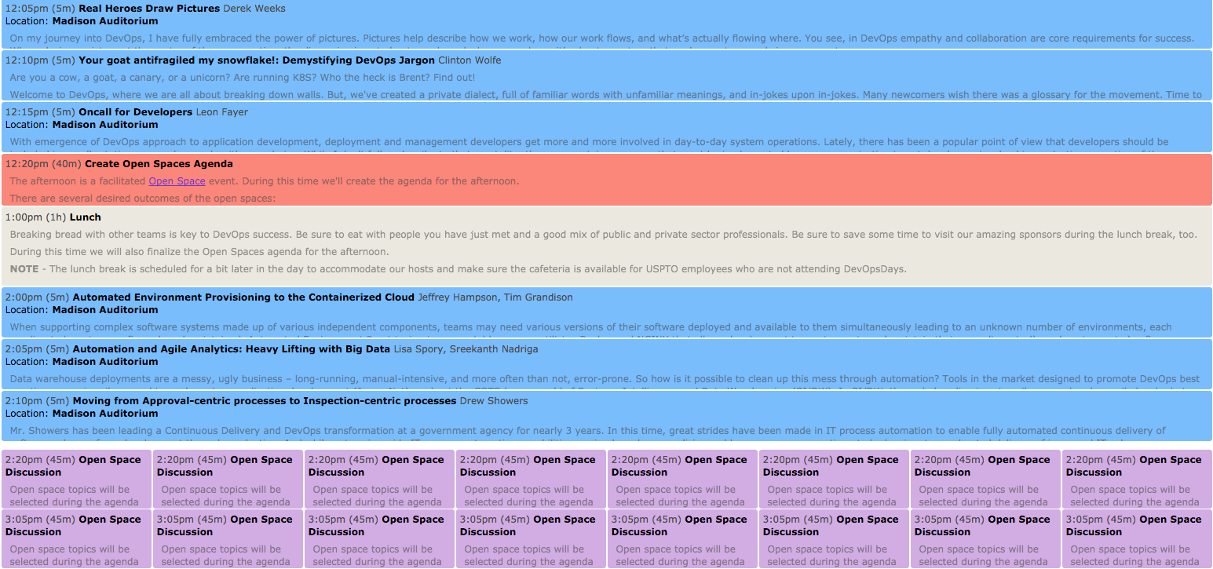
Wednesday Afternoon

Slide 37

Gold Sponsor
@infozencorp

Slide 38

Gold Sponsor
@comcast

Slide 39

Gold Sponsor
@karsunllc

Slide 40
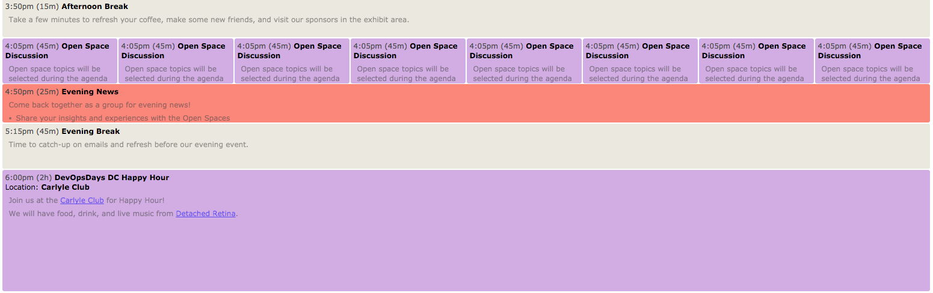
Wednesday Afternoon & Evening

Slide 41

Gold Sponsor

Slide 42

Gold Sponsor
@evidentdotio

Slide 43

Gold Sponsor
@victorops

Slide 44
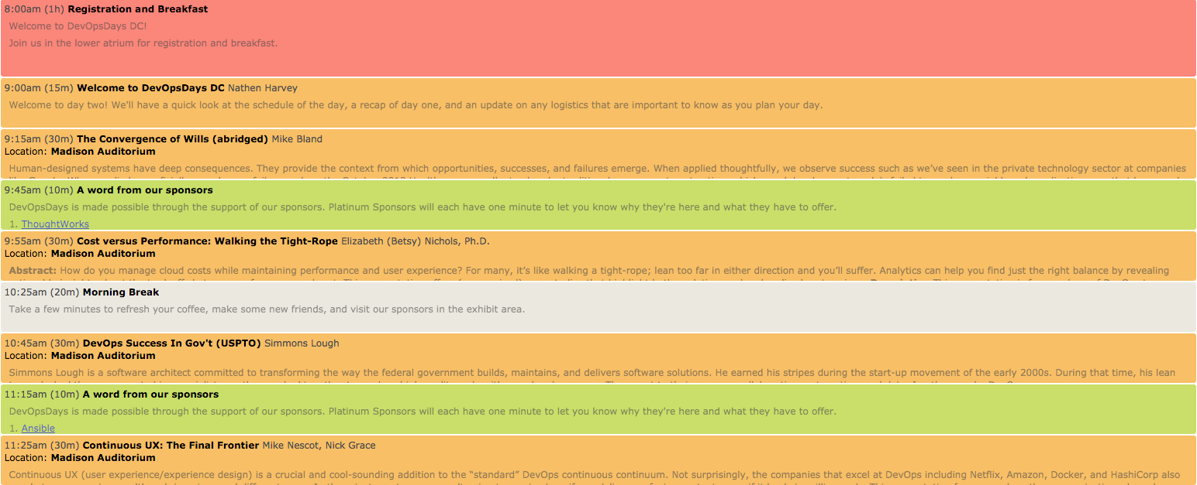
Thursday Morning

Slide 45

Gold Sponsor
@cloudbees

Slide 46
Gold Sponsor
@fanniemae

Slide 47
aol
Logo Designed by
Terry Watkins

Slide 48
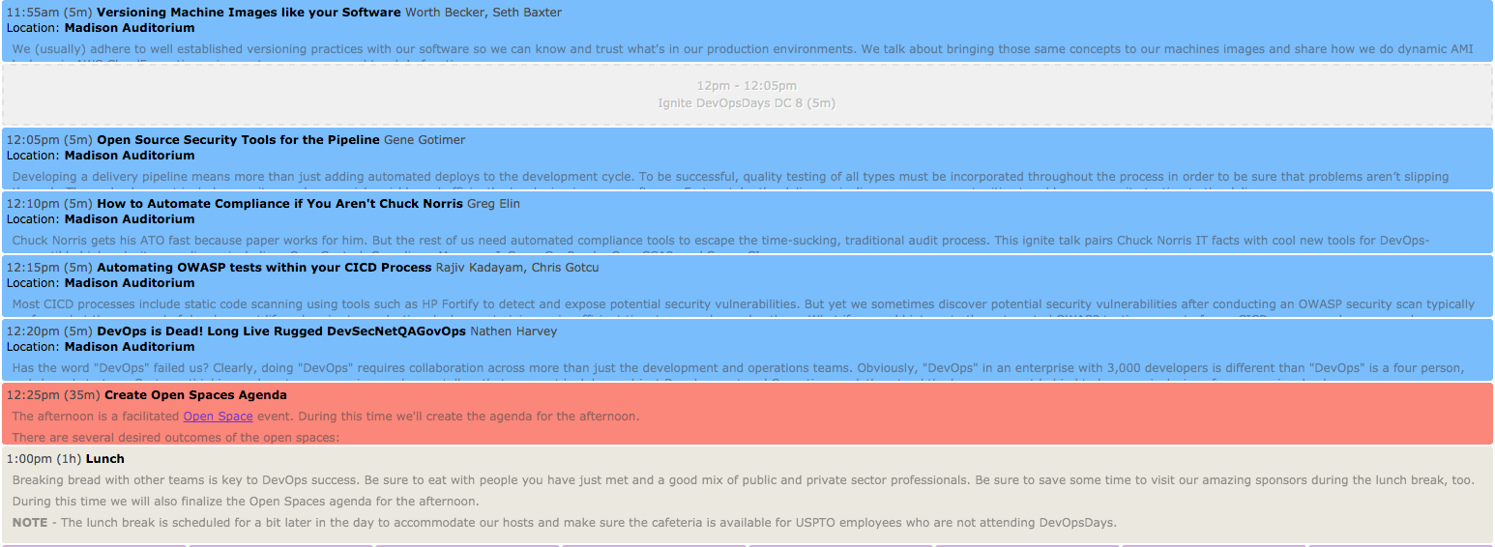
Thursday Afternoon

Slide 49

Silver Sponsor
@sonatype

Slide 50

Silver Sponsor
@halvikcorp

Slide 51

Silver Sponsor
@jhctechnology

Slide 52
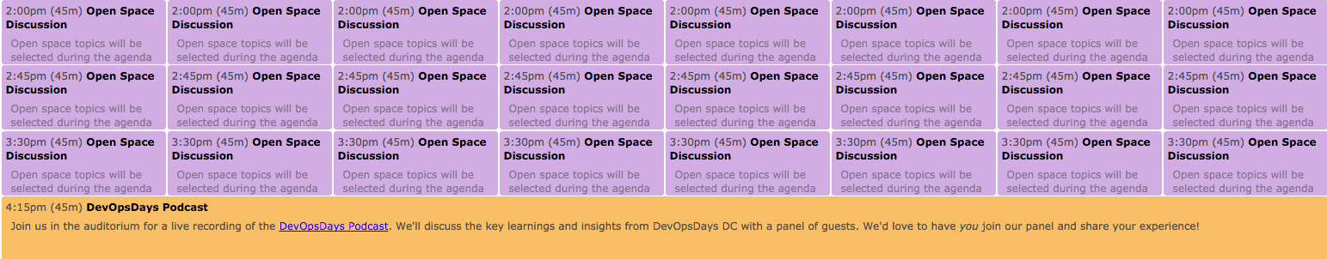
Thursday Afternoon

Slide 53

Silver Sponsor
@stsiinc

Slide 54

Silver Sponsor
@phishme

Slide 55

Silver Sponsor
@govready

Slide 56

August 16-17

Slide 57

Silver Sponsor
@solidfire

Slide 58

Silver Sponsor
@fearlesssol

Slide 59

Silver Sponsor
@aisteam

Slide 60
